Slide 1

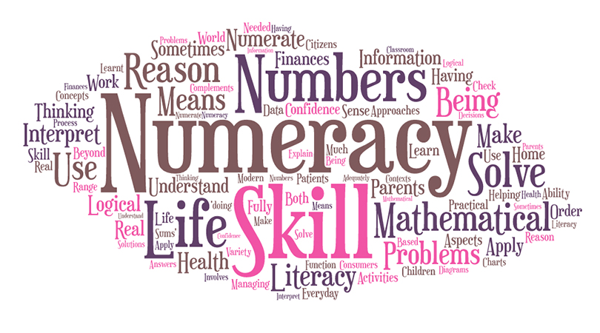
Boclair Academy
Family Learning Event
23rd September 2026
Supporting Numeracy at Home

Slide 2
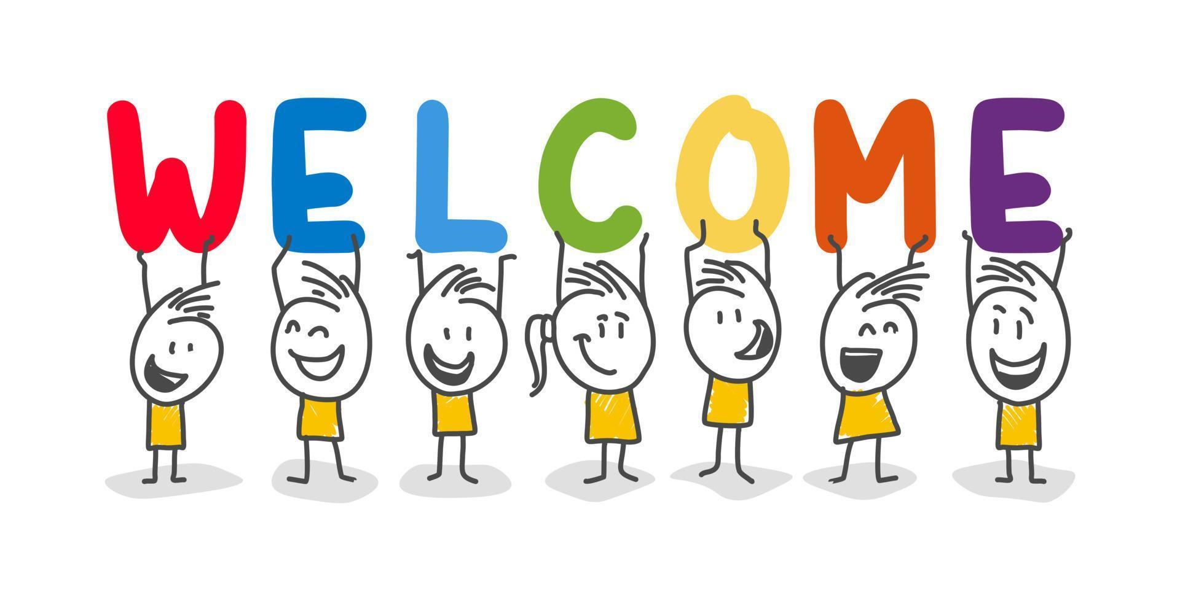
Supporting Numeracy at Home
Mr D. Muir
Principal Teacher of Numeracy
Teacher of Mathematics
dmuir@boclair.e-dunbarton.sch.uk

Slide 3
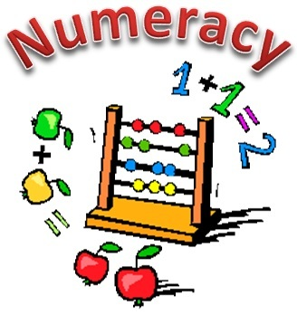
What is numeracy?
Numeracy is the ability to understand and use maths in daily life; at home, work or school. Numeracy does not involve complex mathematical skills, it means being confident at using basic mathematical skills in real life situations.

Slide 4
Why is numeracy important?
Improving key numeracy skills enables learners to:
develop essential skills which will allow learners to fully participate in society
understand that successful independent living requires financial awareness, effective money management, using schedules and other related skills
interpret numerical information appropriately and use it to draw conclusions, assess risk, make reasoned evaluations and informed decisions

Slide 5
Why is numeracy important? (cont.)
Improving key numeracy skills enables learners to:
apply skills and understanding creatively and logically to solve problems, within a variety of contexts
appreciate how the imaginative and effective use of technologies can enhance the development of skills and concepts

Slide 6
What are key numeracy skills?
Key skills in numeracy include:
essential arithmetic skills such as addition, subtraction, multiplication and division
working with fractions, decimals and percentages
calculating and using measurements
working with ratios and being able to convert between units
interpreting data, charts and diagrams
solving problems

Slide 7
How can you help at home?
To improve numeracy skills at home:
encourage a positive mind-set when it comes to using numeracy skills
encourage young people to take an active part in shopping and budgeting
discuss measurements and proportions when cooking and using recipes
encourage young people to take more control of their time management

Slide 8
How can you help at home? (cont.)
To improve numeracy skills at home:
discuss distances and score keeping during sports and games
work out sale discounts using percentages either online or in shops
allow young people to take measurements and calculate dimensions when carrying out DIY tasks
play games and use interactive resources to improve numeracy skills
make use of the Boclair Academy Numeracy Booklet

Slide 9
Boclair Academy Numeracy Booklet
The Boclair Academy Numeracy Booklet is available to download on the school website with paper copies available from the Mathematics department if required
The aim of the booklet is to assist young people using numeracy skills across all areas of school and at home
The booklet is designed to embed consistent language and methods between all school departments and at home
It is filled with information, examples and ideas to help improve numeracy skills
It will be updated throughout the year to include further examples of using numeracy skills in other subject areas and outside of school

Slide 10
Online Resources
The following websites are useful for improving numeracy skills:
www.bbc.co.uk/bitesize/secondary
  Choose level 3 and 4 mathematics content
  www.mathsworkout.co.uk
    Interactive resources
    Username: Boclair Password: graph26
  www.corbettmaths.com
    Revision questions and videos for a range of topics
  www.nrich.maths.org
    Range of resources for young people and adults to use at home
  www.nationalnumeracy.org.uk
    Help and advice for adults to support young people with numeracy at home

Slide 11
Numeracy activities at home
The following activities are just some of the ways you can help to improve numeracy skills at home:
Ratios and proportion
  Challenge your child to use their knowledge of ratios and proportions to adapt a recipe. For example, ask them to change a recipe that feeds 6 people to one that feeds 4 people. To test their changes, help them to make a meal with the new recipe.
Percentages
  Look at the sales rack in a clothes shop. Ask your child to calculate the discount and the new cost of items included in the sale. For example, a jumper costs £48 and is included in a 20% off sale. How much will the jumper be discounted by and what is the new cost of the jumper?

Slide 12
Talking Positively about Maths
It’s important to be positive about maths and numeracy around young people. The way we talk about maths makes a big difference to how they see it.
Saying things like “I can’t do maths” or “I hated maths at school” might make your child start to think like that too.
Instead of saying the phrases above we could try “I found maths difficult too, but if we keep working at it, we can get it”.
Whatever our own feelings about maths, being positive about maths can make a real difference to the progress of young people

Slide 13
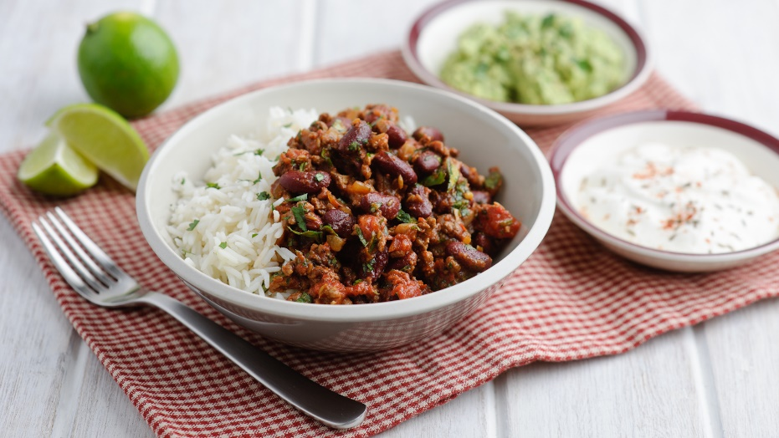
Task – Making Chilli
Sarah wants to make chilli con carne.
The small cards on each desk are all of the tasks that need to be completed and the time required for each task.
Put all of the tasks in order and calculate the total time taken for Sarah to make her meal.
Information on precedent tasks and the table provided should help in this example.

Slide 14

Thank you for attending!

