Slide 1
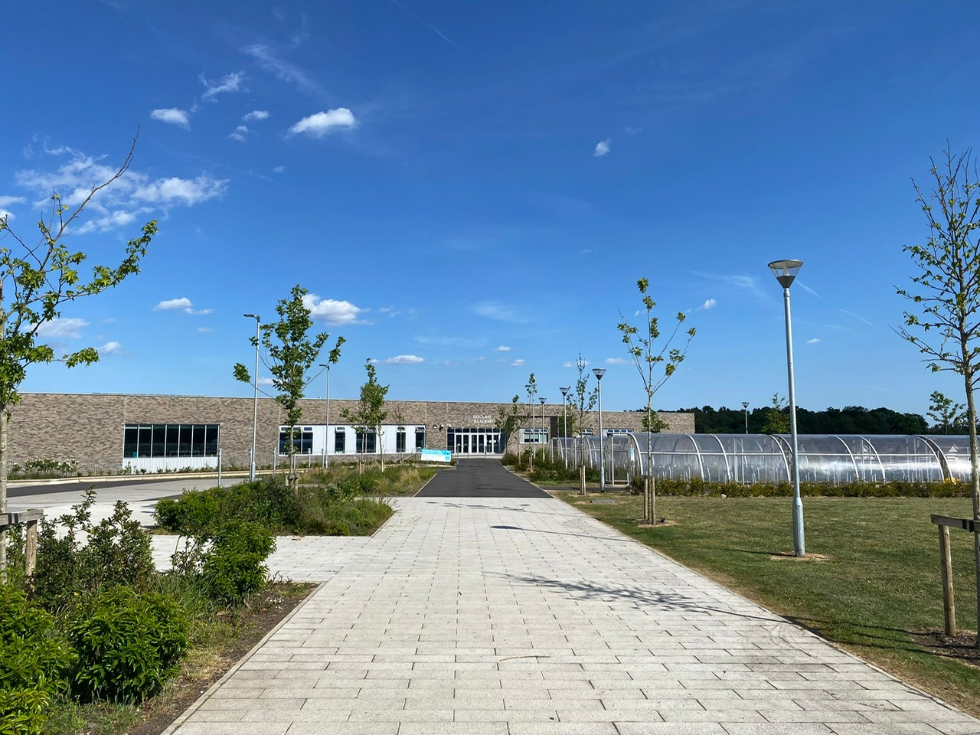
Boclair Academy
P7 Welcome Evening

Slide 2
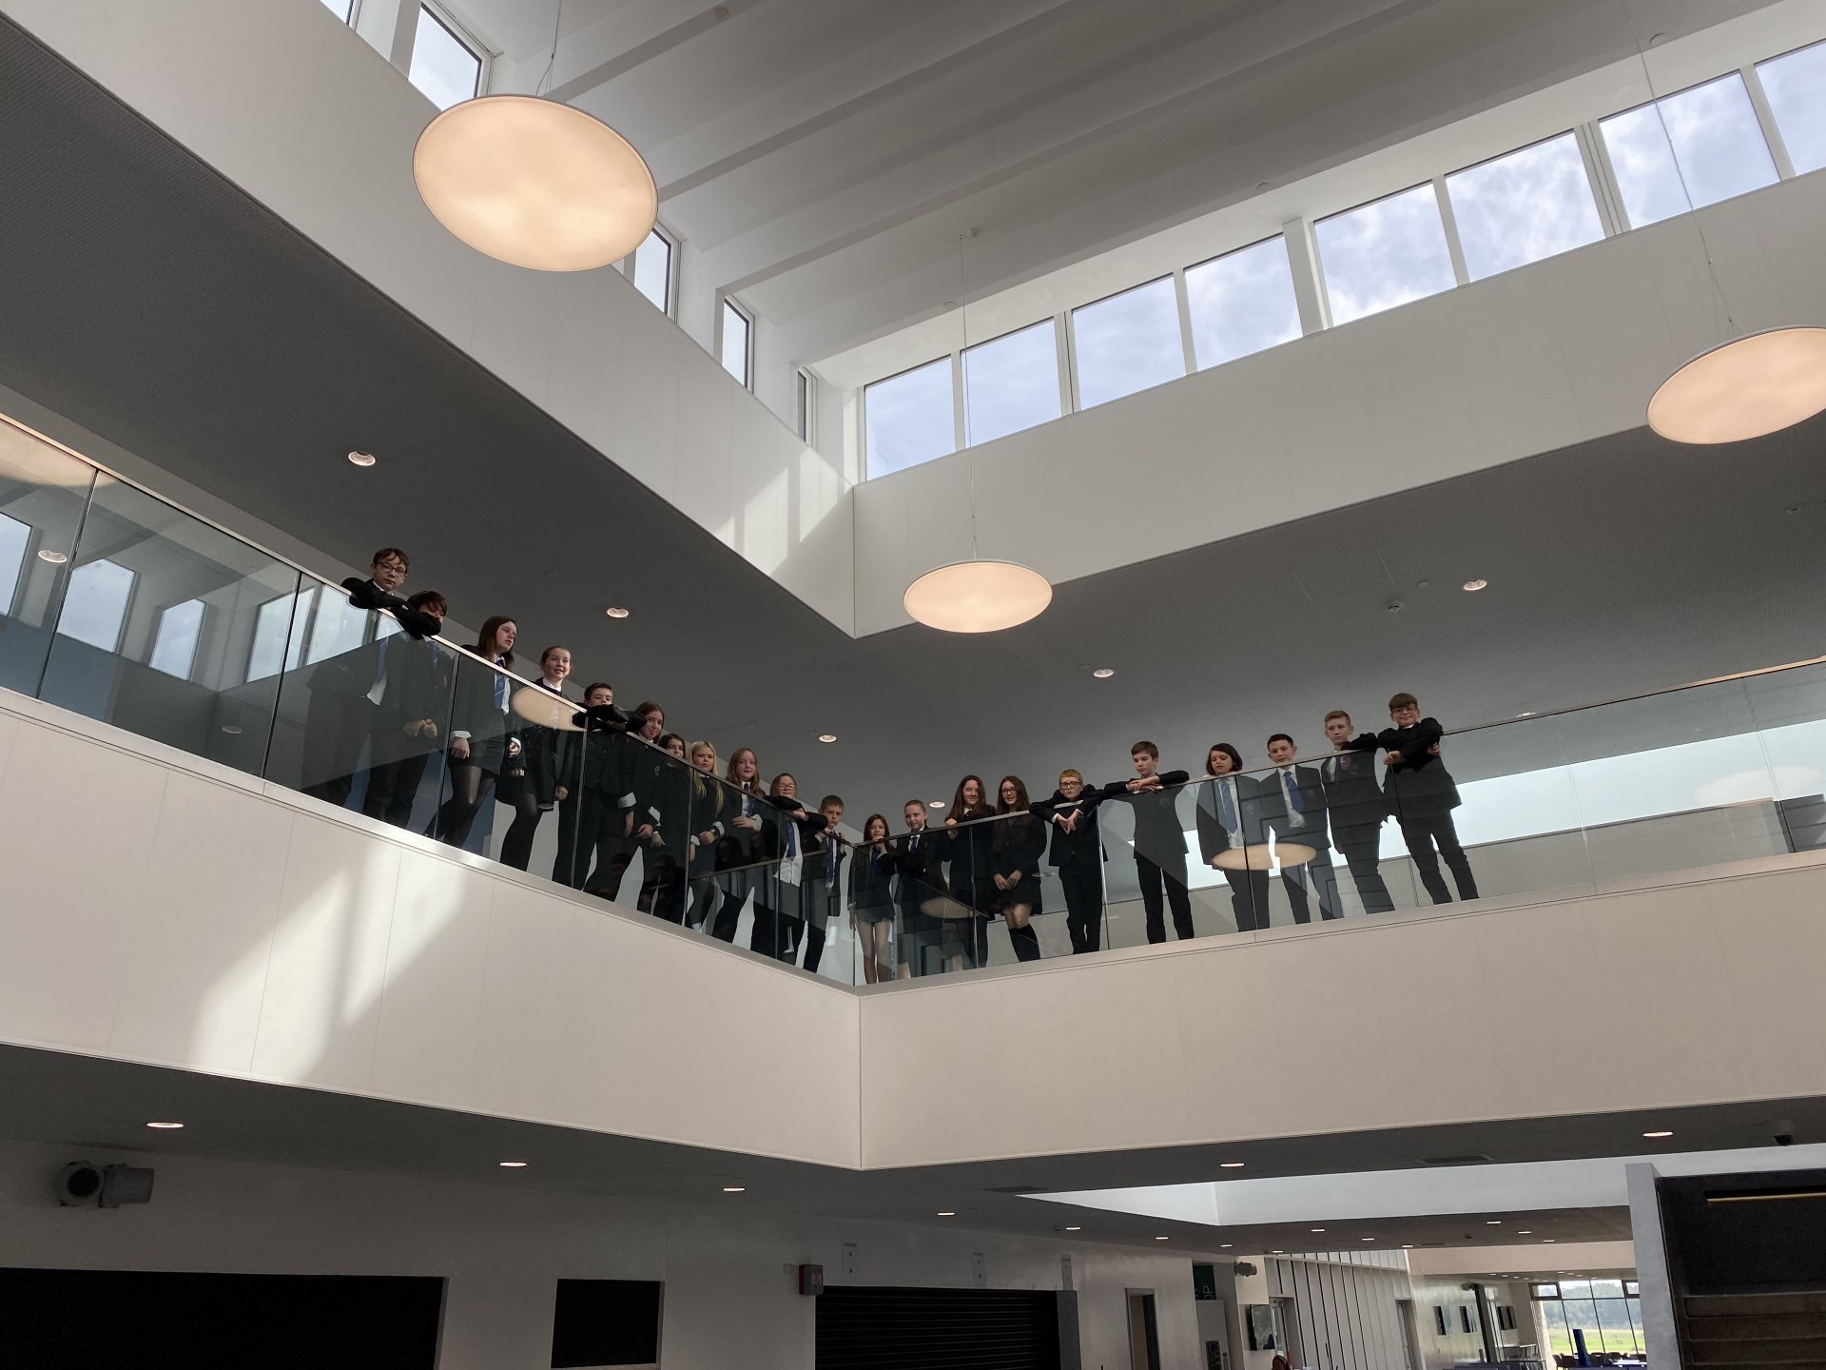
Boclair Academy
Overview

Slide 3
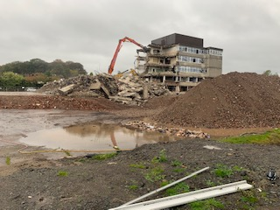
Old Boclair
Boclair Academy

Slide 4
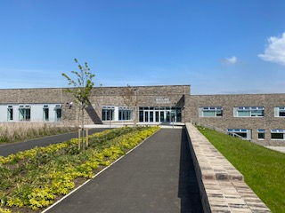
Welcome to the future

Slide 5
Key pillars for success
Building a nurturing school
Building a trauma informed school
Building a poverty aware school
Building a mentally healthy school
Boclair Academy

Slide 6
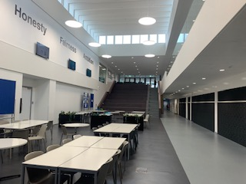
Height Light and Space
Boclair Academy

Slide 7
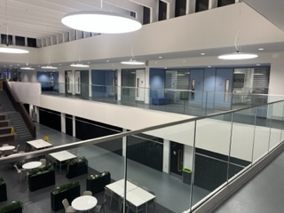
Boclair Support Spine

Slide 8
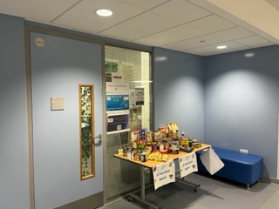
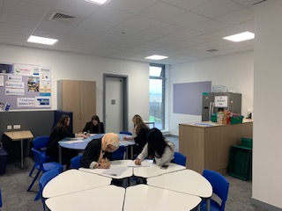
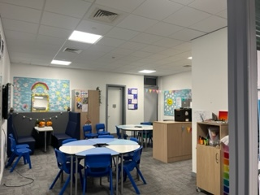
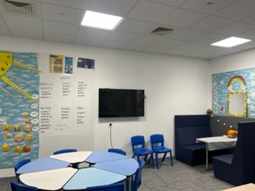
Achievement Resource

Slide 9
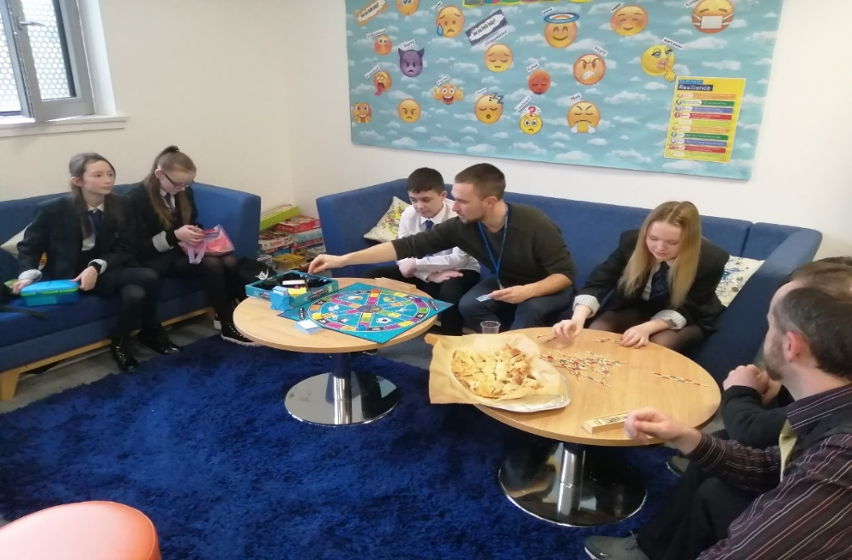
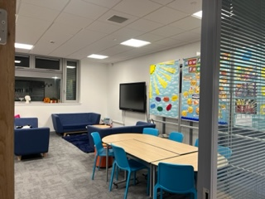
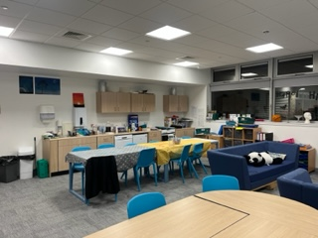
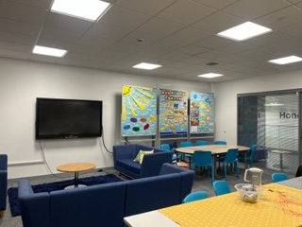
Wellbeing Resource

Slide 10
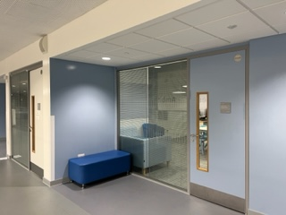
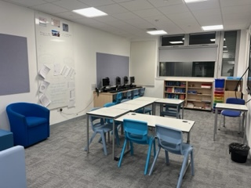
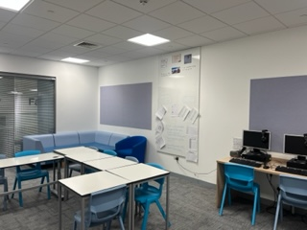
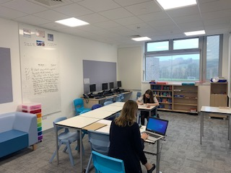
ASN Resource

Slide 11
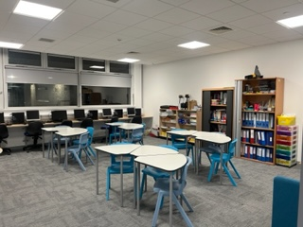
SfL Resource

Slide 12
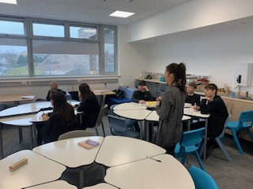
Boclair Learning Resource

Slide 13
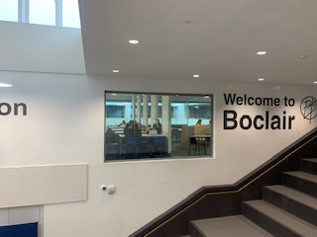
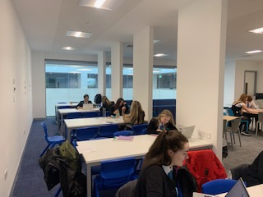
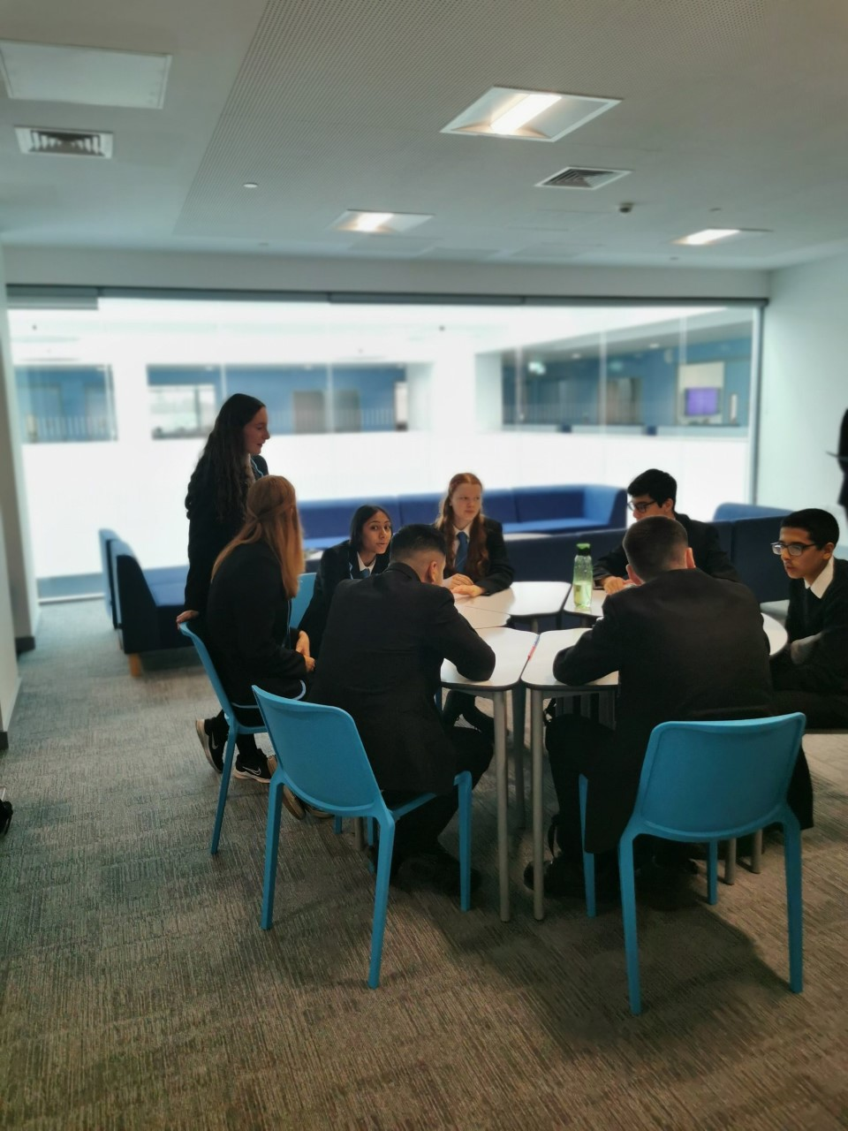
S6 Learning Zone

Slide 14
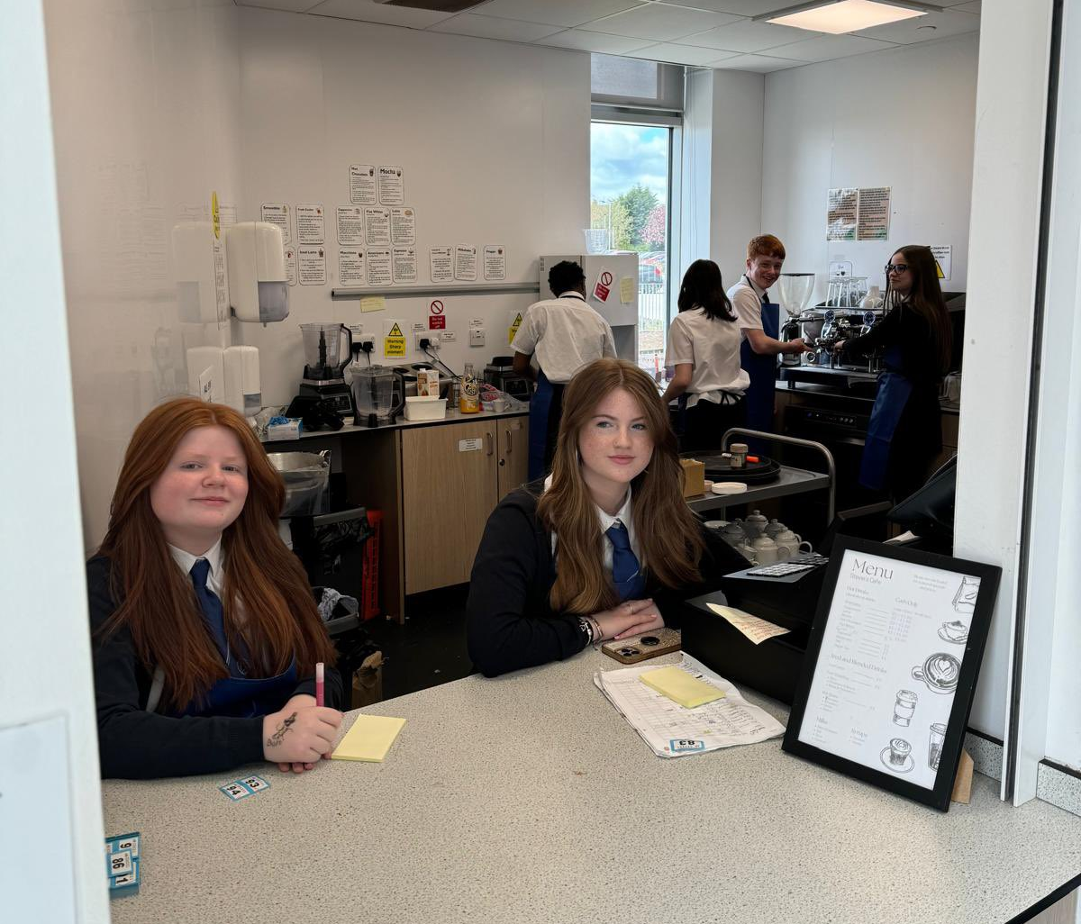
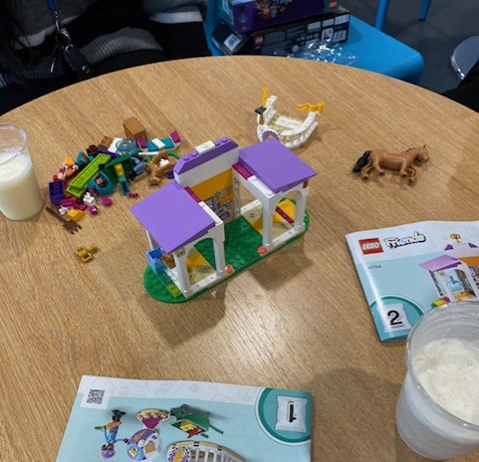
Community Cafe
Sense of belonging and Achievement
Work Experience – skills for work
Team building and confidence
Buddy Meetings between
S6 and S1
Creative learning space – 'Learn with a Latte'
Lego therapy sessions
Hook into school

Slide 15
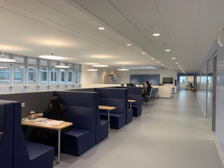
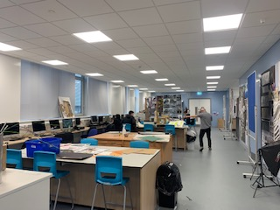
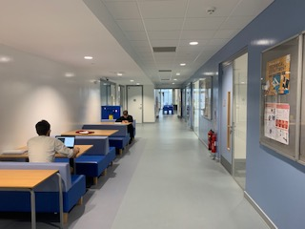
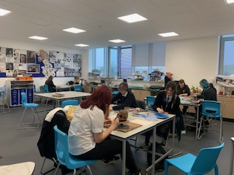
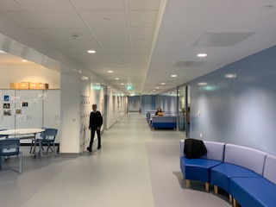
New learning spaces
Boclair Academy

Slide 16
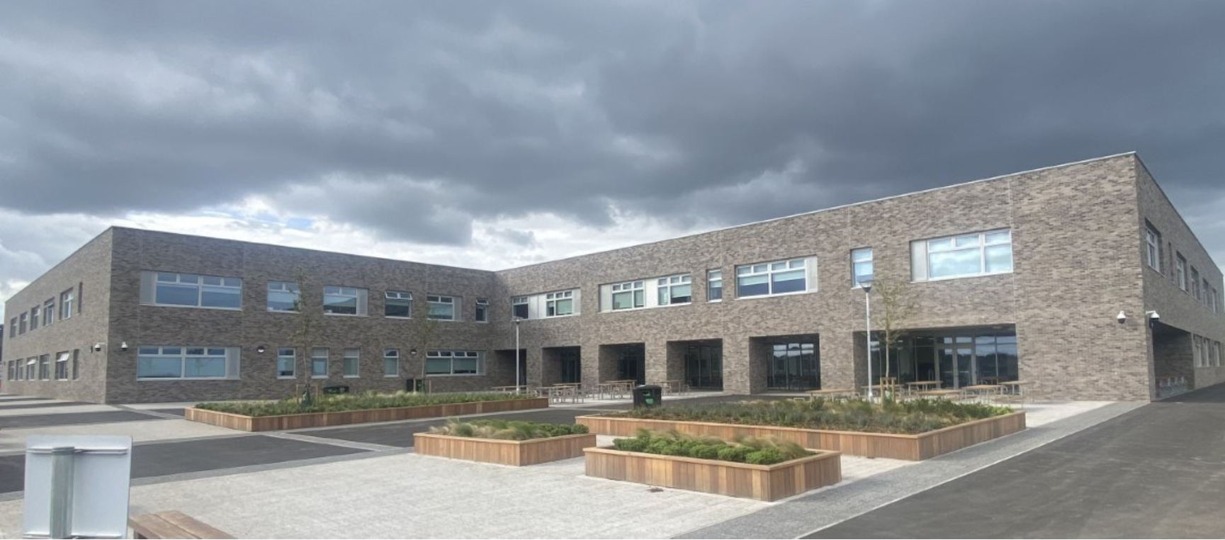
Wider Achievement Programme

Slide 17
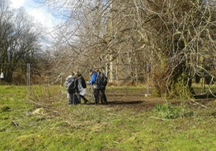
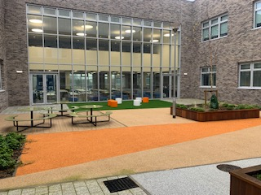
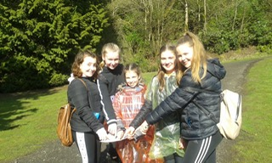
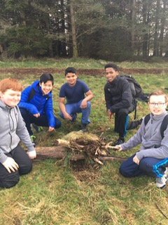
John Muir Award
Boclair Academy

Slide 18
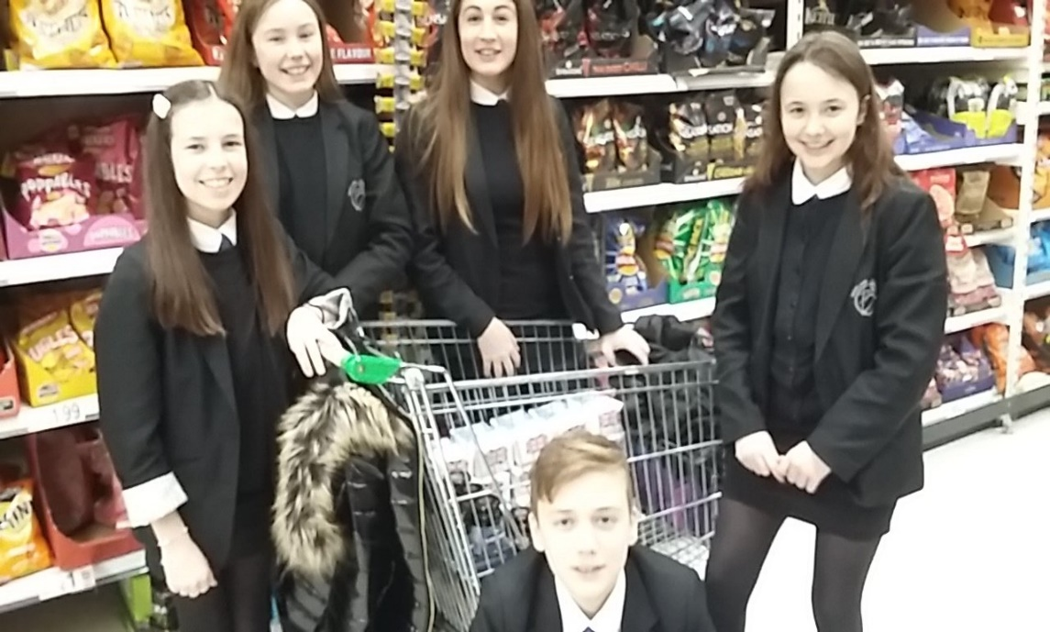
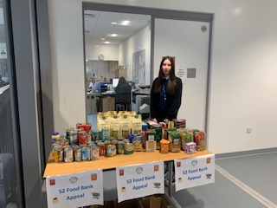
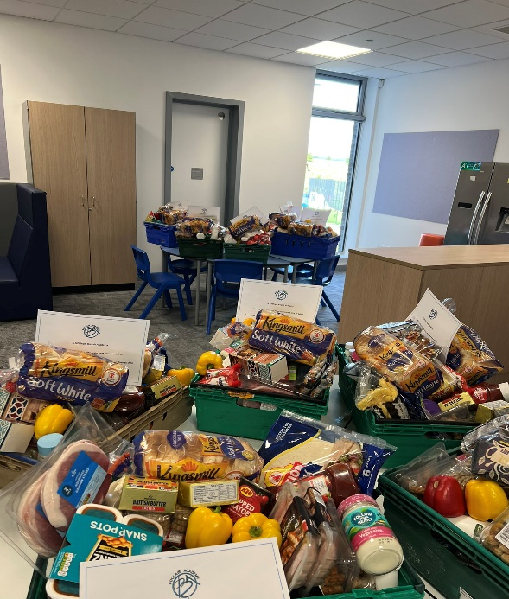
S2 Foodbank Project

Slide 19
S3 Dementia Friends

Slide 20
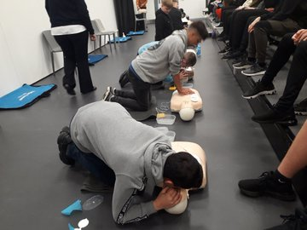
SCQF Level 6 First Aid at work training – S4

Slide 21
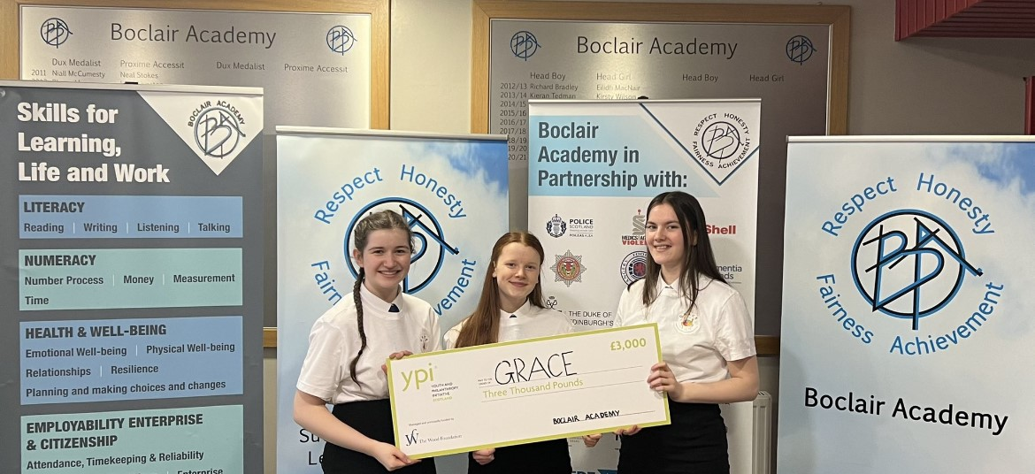
S5

Slide 22
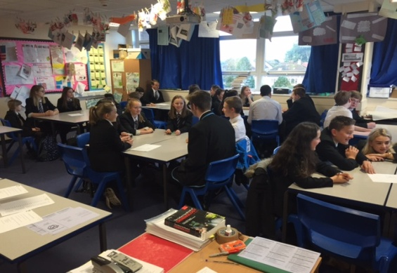
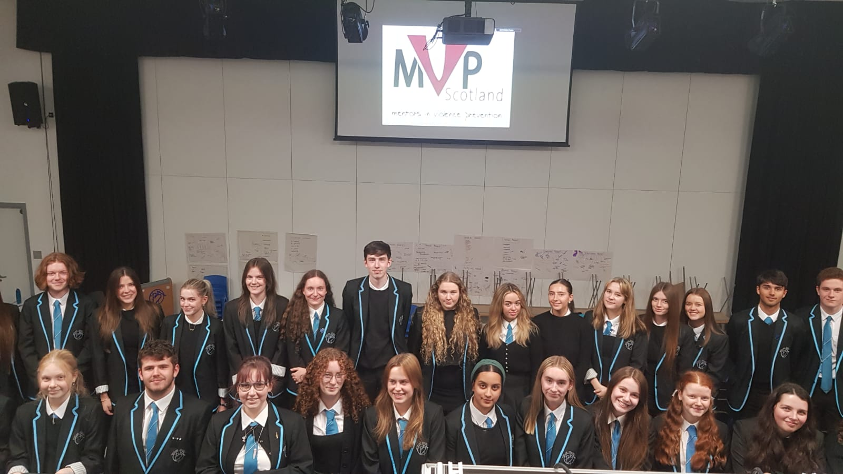

Slide 23
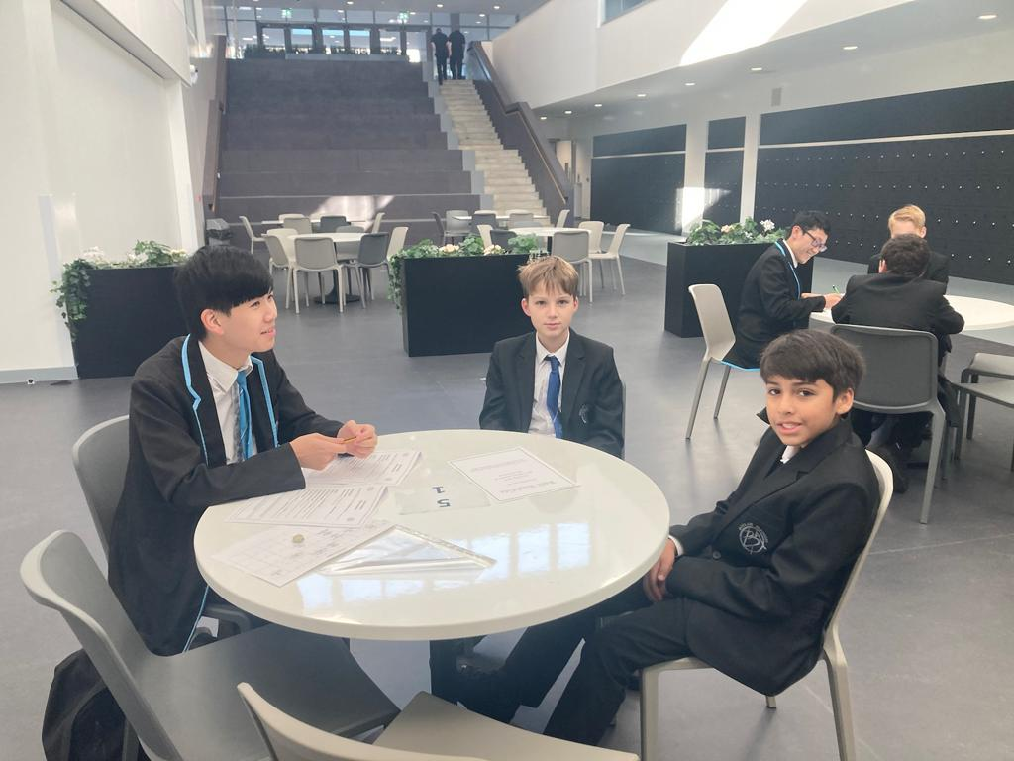
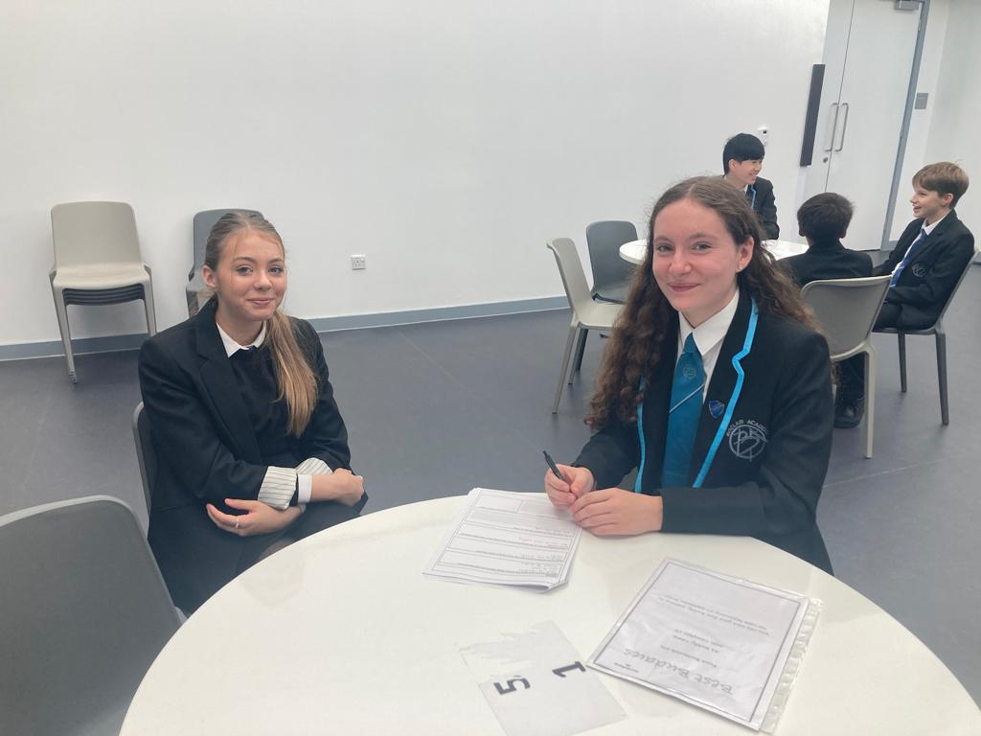

Slide 24
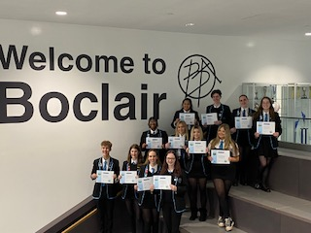
Level 6 Leading Mental Health training

Slide 25
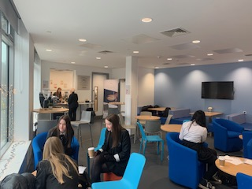
Senior Baristas and work experience for younger pupils
Boclair Academy

Slide 26
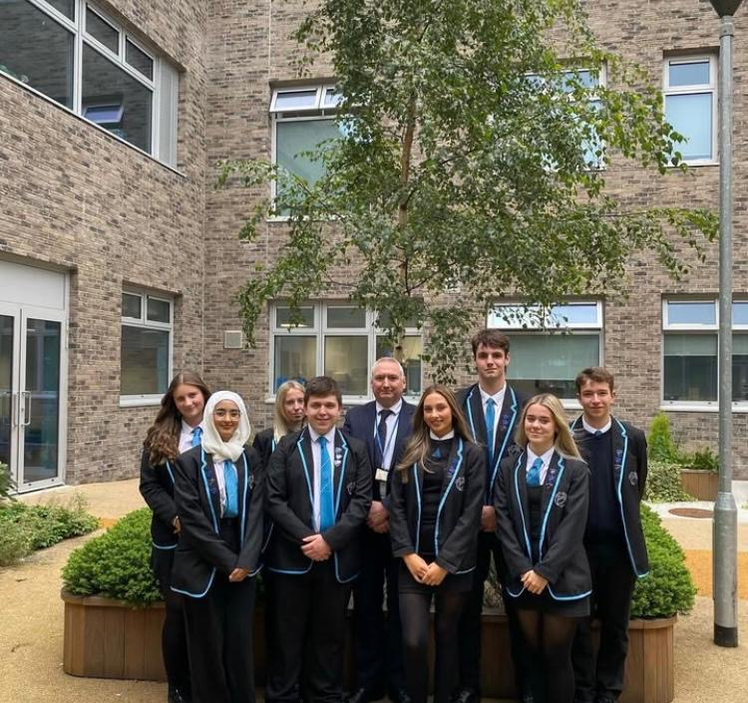
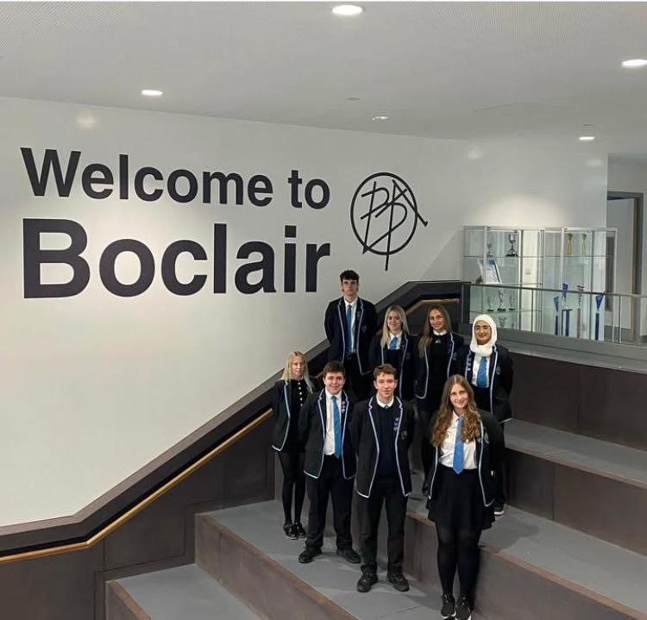
Pupil Leadership
Pupil Leadership
Boclair Academy

Slide 27
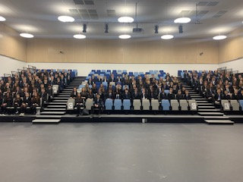
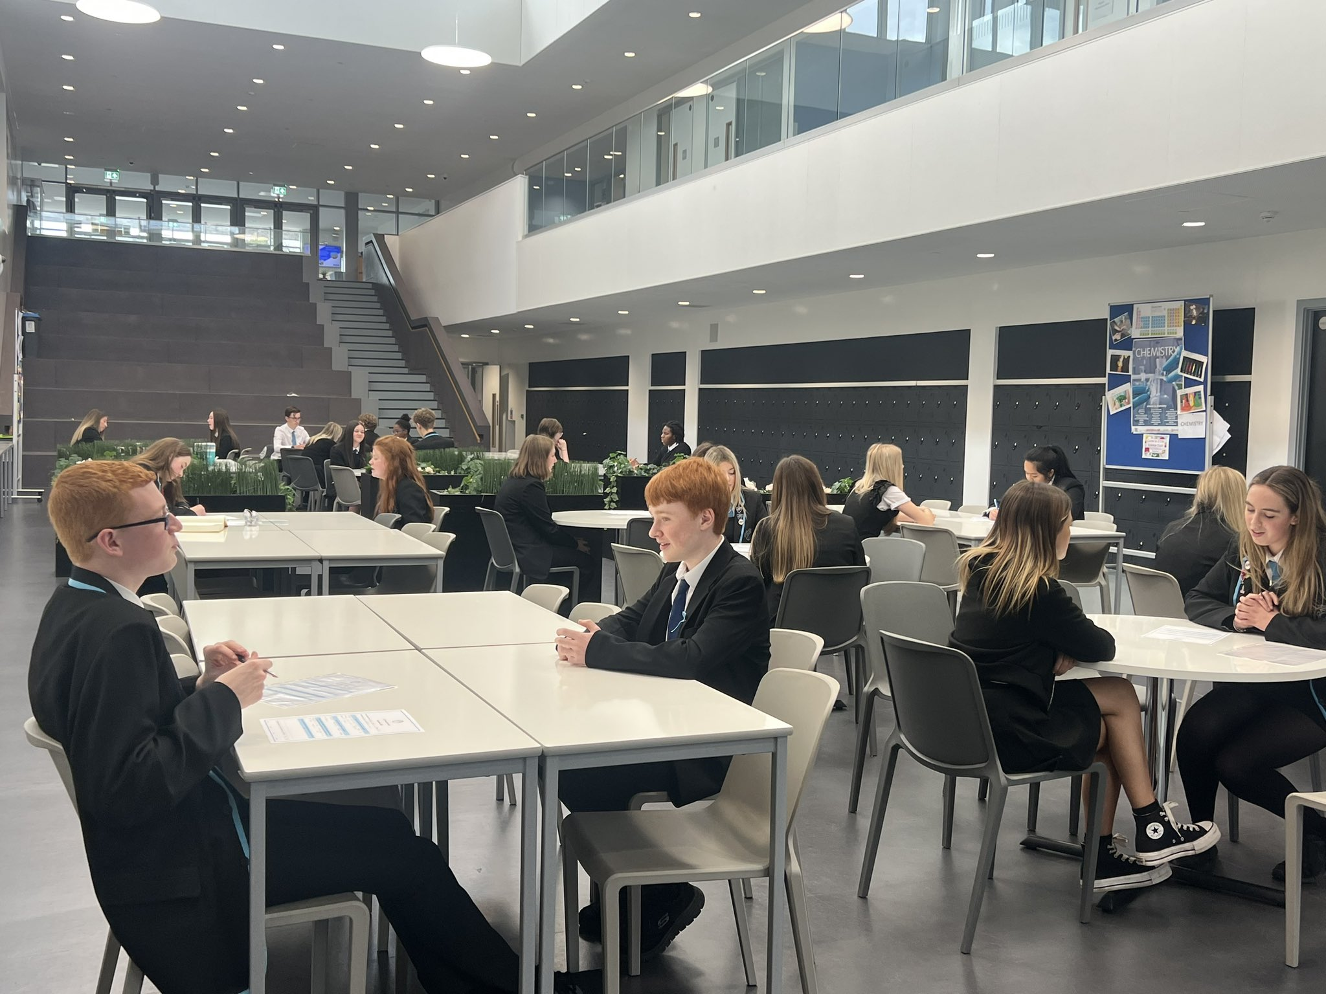
Pupil Voice
Boclair Academy

Slide 28
Toast and breakfast
Boclair Academy

Slide 29
Attainment Overview
Boclair Academy

Slide 30
Leavers 2024 - Improving Attainment for all

Slide 31
Breadth and Depth Leavers – SCQF Awards Boclair
Awards | Level 4 | Level 5 | Level 6 | Level 7 | Cohort
1 or more | 100.00% | 98.13% | 97.50% | 56.25% | 160
2 or more | 100.00% | 97.50% | 91.88% | 26.88% | 160
3 or more | 100.00% | 96.25% | 85.63% | 8.75% | 160
4 or more | 100.00% | 96.25% | 80.00% | 1.25% | 160
5 or more | 98.13% | 94.38% | 76.88% | 0.00% | 160
6 or more | 96.88% | 90.63% | 71.88% | 0.00% | 160
7 or more | 94.38% | 86.25% | 60.63% | 0.00% | 160

Slide 32
Breadth and Depth Leavers – SCQF Awards VC
Awards | Level 4 | Level 5 | Level 6 | Level 7 | Cohort
1 or more | 99.19% | 97.13% | 88.94% | 42.94% | 1600
2 or more | 98.31% | 95.56% | 81.81% | 20.00% | 1600
3 or more | 97.63% | 93.13% | 75.44% | 7.50% | 1600
4 or more | 96.50% | 90.63% | 69.56% | 0.75% | 1600
5 or more | 95.00% | 86.75% | 62.81% | 0.06% | 1600
6 or more | 93.19% | 82.44% | 48.19% | 0.00% | 1600
7 or more | 90.13% | 76.44% | 32.75% | 0.00% | 1600

Slide 33
Breadth and Depth Leavers – SQA A-C Awards Boclair
Awards | Level 4 | Nat 5 C | Nat 5 B | Nat 5 A | Higher C | Higher B | Higher A | AH C | Cohort
1 or more | 100.00% | 96.88% | 96.25% | 92.50% | 90.00% | 75.63% | 63.13% | 41.25% | 160
2 or more | 100.00% | 95.63% | 91.88% | 89.38% | 80.00% | 67.50% | 48.75% | 17.50% | 160
3 or more | 99.38% | 93.75% | 87.50% | 81.25% | 71.25% | 58.13% | 40.00% | 6.25% | 160
4 or more | 98.75% | 90.63% | 81.25% | 78.13% | 65.00% | 48.13% | 28.75% | 0.63% | 160
5 or more | 97.50% | 85.63% | 70.63% | 68.13% | 54.38% | 40.00% | 23.13% | 0.00% | 160
6 or more | 96.25% | 76.25% | 63.75% | 56.88% | 41.25% | 29.38% | 12.50% | 0.00% | 160

Slide 34
Breadth and Depth Leavers – SQA A-C Awards VC
Awards | Level 4 | Nat 5 C | Nat 5 B | Nat 5 A | Higher C | Higher B | Higher A | AH C | Cohort
1 or more | 99.00% | 95.81% | 93.13% | 89.00% | 82.56% | 71.81% | 58.13% | 34.31% | 1600
2 or more | 98.06% | 92.81% | 86.38% | 81.75% | 71.38% | 60.06% | 42.38% | 14.19% | 1600
3 or more | 97.06% | 88.44% | 79.75% | 74.31% | 64.38% | 50.94% | 31.25% | 4.69% | 1600
4 or more | 95.81% | 83.06% | 74.06% | 67.75% | 56.56% | 42.56% | 23.38% | 0.56% | 1600
5 or more | 94.13% | 77.38% | 67.63% | 60.38% | 47.75% | 31.63% | 15.38% | 0.00% | 1600
6 or more | 91.19% | 70.50% | 59.25% | 51.19% | 30.31% | 18.19% | 7.25% | 0.00% | 1600

Slide 35
National Perspective

Slide 36
Breadth and Depth Leavers

Slide 37
Breadth and Depth Leavers

Slide 38
Breadth and Depth Leavers

Slide 39
Boclair Academy
Transition

Slide 40
New S1
Parents Information Evening
21st May 2025

Slide 41
Mrs Gillespie & Miss Hossack Principal Teachers of Guidance

Slide 42
Role of Guidance Teacher
Provide daily support for young people.
Monitor attendance, timekeeping and progress.
Point of contact for parents/carers.
Delivery of Personal and Social Education

Slide 43
P7 Transition Process
September 2024 - Meeting with Primary Head Teachers
January - literacy & numeracy lessons, conversations with each pupil
February - STEM/Business Day at Boclair, further discussions with class teacher
March - Support for Learning visits
May - Meeting with Primary 7 teachers/SLT
June - Induction Days
June - Finalise class lists for August
Notes:
We appreciate that the transition to secondary school can be a very anxious. We have reviewed our process this year so that we know the pupils really well and have put a lot of thought in to class grouping for next year.Process started in September 2024
Meeting with Primary Head Teachers
Visited feeder Primary Schools twice in January – numeracy, literacy observed pupils in their learning, spoke to them individually and started discussions with class teachers
Business/STEM in Feb – observed, got feedback from Boclair teachers, further discussions with class teacher
SFL visits in March – further opportunity to observe and speak to pupils
Meeting with Primary 7 teachers to check proposed class groupings
Induction days – final opportunity to observe and will ask for pupil and teacher feedback
Taking all of this information we will work on finalisining class lists for August and information will be communicated via primary schools prior to the summer holidays which will hopefully alleviate any anxiety

Slide 44
Classes
1A – Mr Martin
1B – Miss Hossack
1C – Mr McClure
1D – Mrs Gillespie/Mrs McRae
1E – Mrs McGhee
1F – Miss McKinlay
Practical Set (1.1 – 1.9)
RESPECT HONESTY FAIRNESS AMBITION
Notes:
9 subjects (21 periods) and registration in full class set.
6 subjects (11 periods) in practical set.
Ensure mix of pupils – opportunities for new friendships
Information from primary schools
Class groupings are context for learning.

Slide 45
Uniform
Blazer
Junior tie
Black skirt/trousers
Black shoes/trainers
Plain black jumper
Blazer fitting evenings on Monday 9th and Tuesday 10th of June 6.00 -7.30pm

Slide 46
School Day
Registration at 8:50am
Monday and Tuesday are 7 period days finishing at 15:55.​
Wednesday, Thursday and Friday are 6 period days finishing at 15:05.​
​
S1-S3 interval and lunch at different times to S4-S6
RESPECT HONESTY FAIRNESS AMBITION
Notes:
Importance of registration
First Year dismissed 5 minutes early
Currently reviewing and consulting on break arrangements

Slide 47
​
RESPECT HONESTY FAIRNESS AMBITION
Notes:
Broad General Education continues until end S3. There are eight curriculum areas: expressive arts, health and wellbeing, languages (including English, Gàidhlig and Gaelic learners and modern languages), mathematics, religious and moral studies, sciences, social studies and technologies.
Organisation demands – help to pack bag, help to manage homework. Use of Satchel 1.
Translates into 15 different subjects. Each period lasts 50 minutes.

Slide 48
​Clubs​
​
Board Games Club
Crochet Club
David Attenborough lunch club
STEM Science Club
F1 in Schools STEM club
Junior Creative Writing Club
Junior Book Club
Papercrafting club
Music Groups/Orchestra
Languages Club
Chess Club
Modern Languages Club
Podcast Club
Alliance Club (LGBTQ+)
Duke of Edinburgh
Dance
Cheer
Table Tennis
Volleyball
S1 Football
Girls Football
Rugby
Basketball
Badminton
Netball
Gymnastics
Fitness
Hockey
RESPECT HONESTY FAIRNESS AMBITION
Notes:
Open Evening – showcase of department work in new school building
Cluster Primaries – Christmas Concert rehearsal, visit from junior and senior prefects, maths/mod lang experience in Boclair, 3 lessons from Guidance Teacher, STEM and team building activities at primary.
Non-cluster – team building at Boclair Academy Friday 19th May 2:30pm – 4pm
3 Induction Days – more info
Practical Information for S1

Slide 49
S1 Residential - Lendrick Muir
Week beginning 27th October 2025
Approximate cost £210

Slide 55
​Preparing for Secondary
Talk to them ​
Encourage them to explore their feelings
School website/Instagram
Develop their confidence and independence
Talk to school staff if any worries
Website: http://www.boclair.e-dunbarton.sch.uk
Instagram:boclairacademy1
RESPECT HONESTY FAIRNESS AMBITION
Notes:
Most children will manage the transition to secondary school successfully. However, there may be ups and downs. It’s easy for children to slip from feeling happy and confident one minute, to feeling nervous or anxious and back again as they find their feet.
It's normal to feel both excited and nervous. It can take time to settle into new places with new people and new routines.
Look at the school website and Twitter. Plan their journey to school. Encourage them to join clubs. Explore how they will approach meeting new people and starting conversations. Lots of praise when doing things well.

Slide 57
End

