Slide 1
S4 into S5 Course Choice Information Evening February 2025
Respect Honesty Fairness Ambition

Slide 2
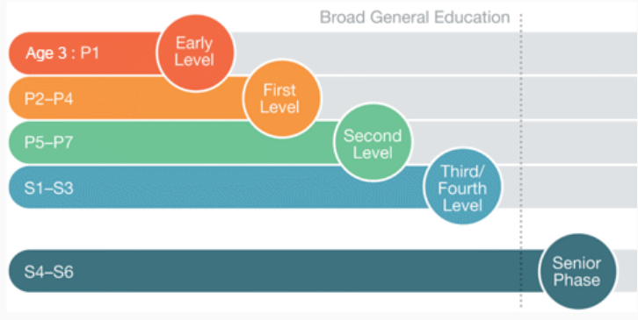
S4 into S5 Course Choice
Respect Honesty Fairness Ambition

Slide 3
Course Choice for S5
In S5 pupils take forward 5 out of their current 7 subjects
All S5 pupils study English and choose 4 other subjects
Pupils should choose subjects based around:
Progression
Interest & Achievement
Career Aspirations & Future Pathways
All pupils will also have core PSE and PE as part of their curriculum
Respect Honesty Fairness Ambition

Slide 4
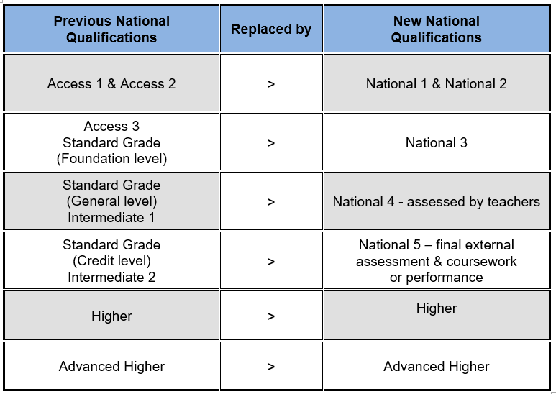
Respect Honesty Fairness Ambition

Slide 5
In S5 young people should select subjects / course to maximise their attainment profile and give them their best chance of securing their intended post school destination
Respect Honesty Fairness Ambition

Slide 6
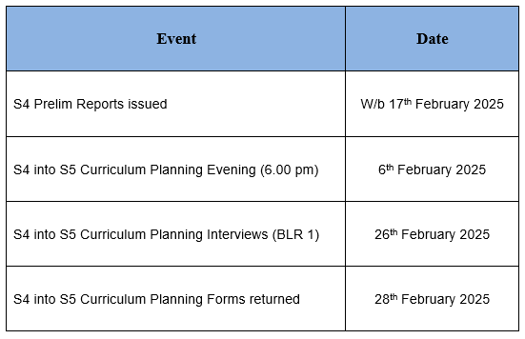
Respect Honesty Fairness Ambition

Slide 7
General Advice
DO select your five strongest subjects
DO remember that we cannot guarantee first choice subject combinations
DO research around your chosen pathway / courses
DON’T worry if you need to make changes at a later date
DON’T select subjects based around the teachers
DON’T select subjects based around your friends
Respect Honesty Fairness Ambition

Slide 8
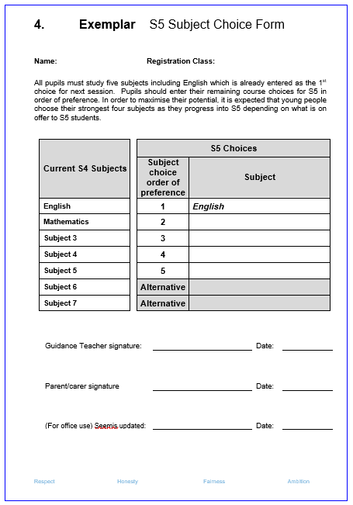
Respect Honesty Fairness Ambition

Slide 9
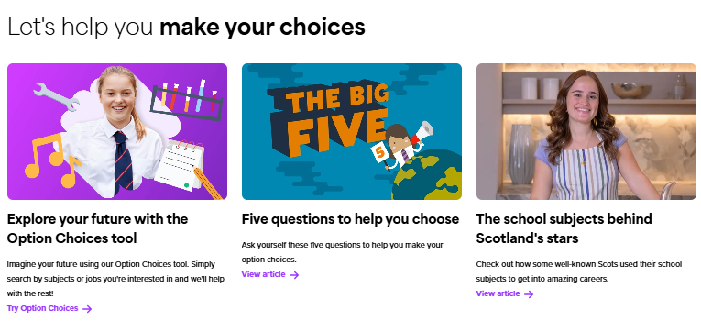
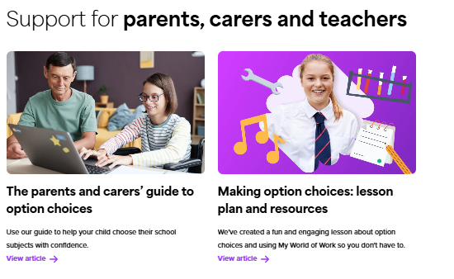
Further Support
Respect Honesty Fairness Ambition

Slide 10
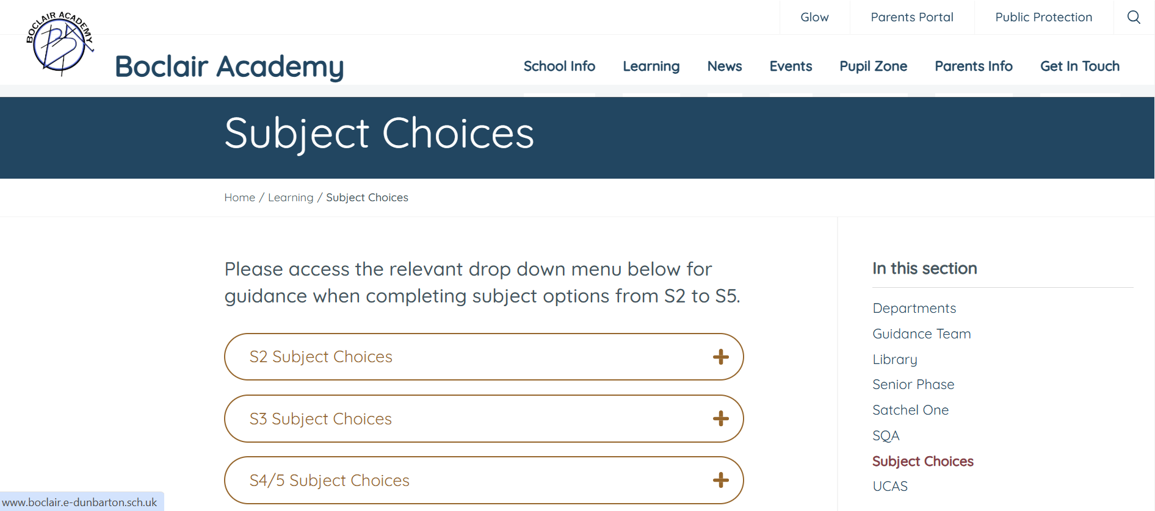
School Website
Respect Honesty Fairness Ambition

